Slide 1
Feature Translation
More Regression and Classification approaches

Slide 2
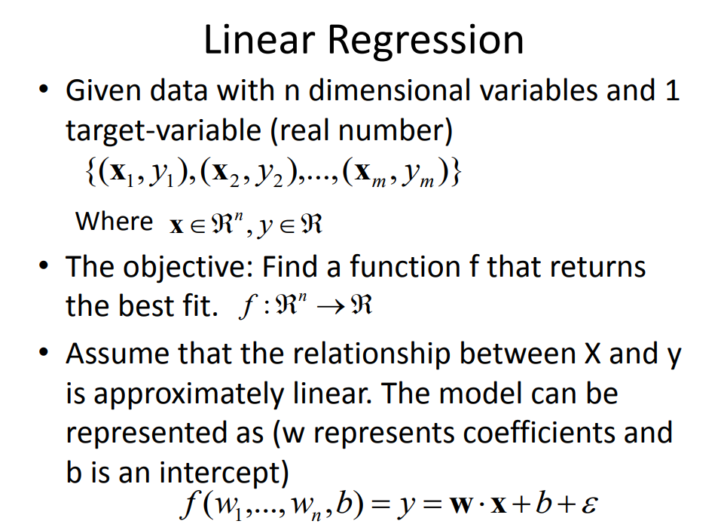

Slide 3
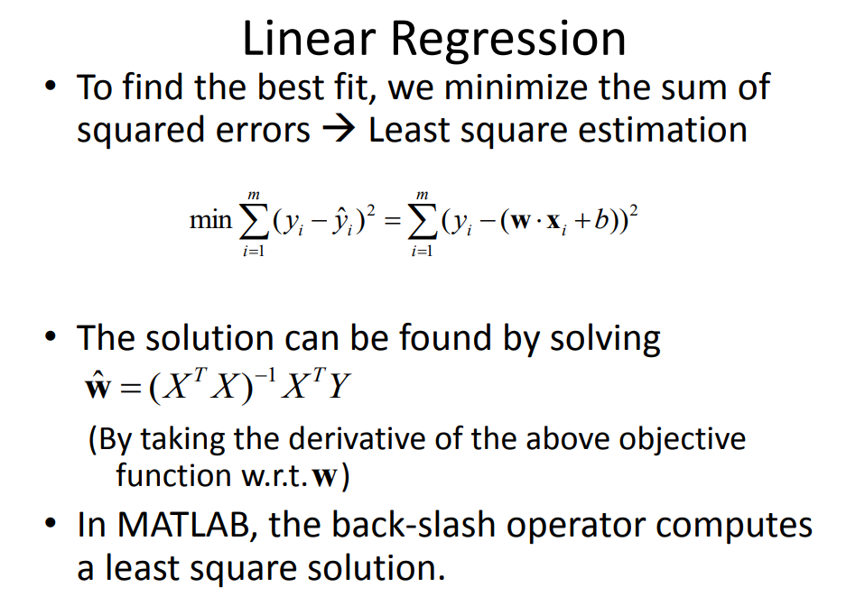

Slide 4
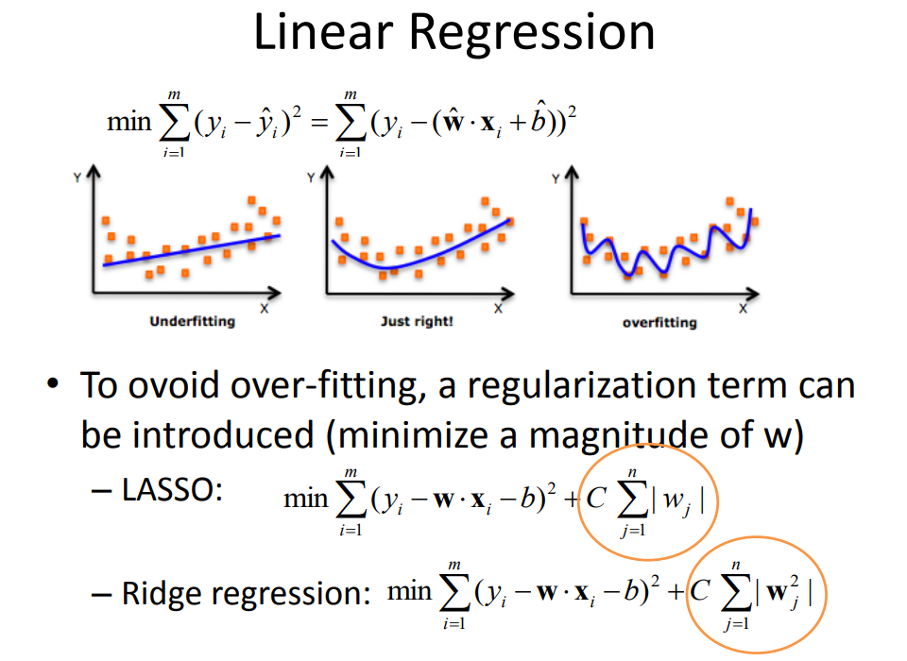

Slide 5
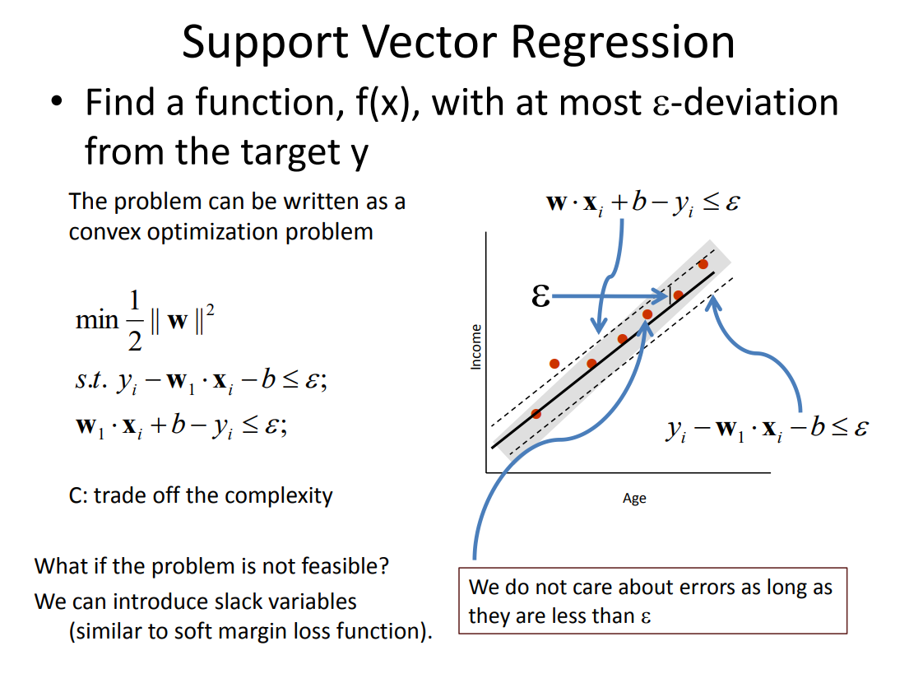

Slide 6
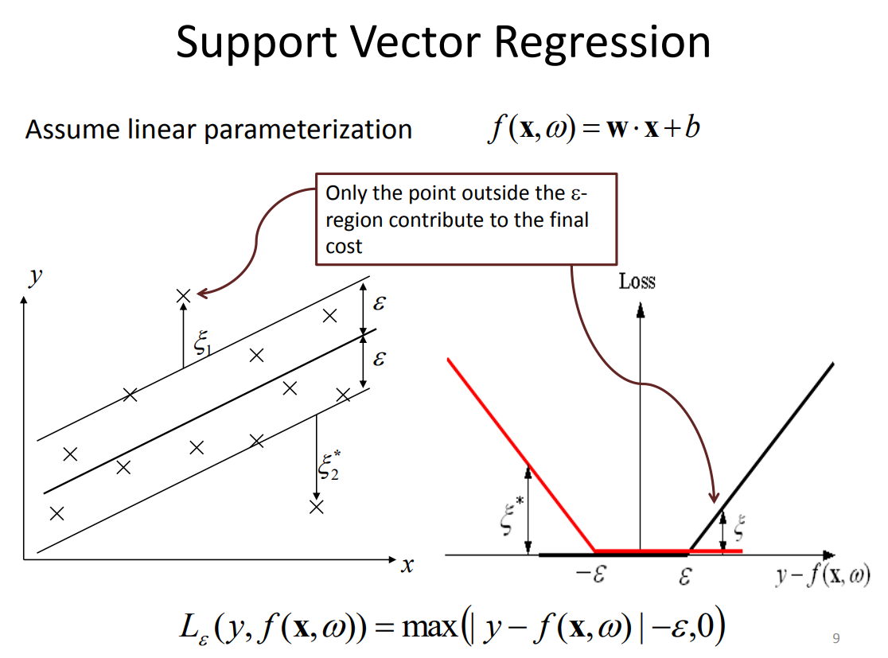

Slide 7
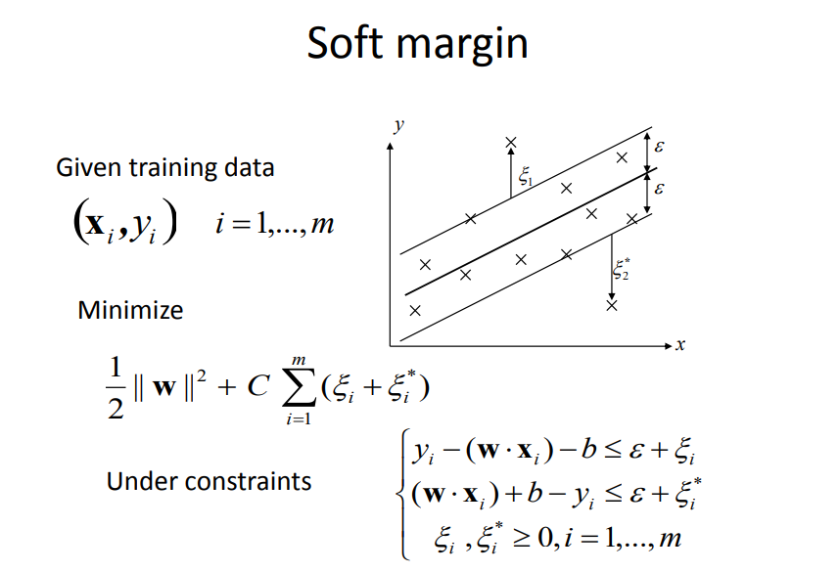

Slide 8
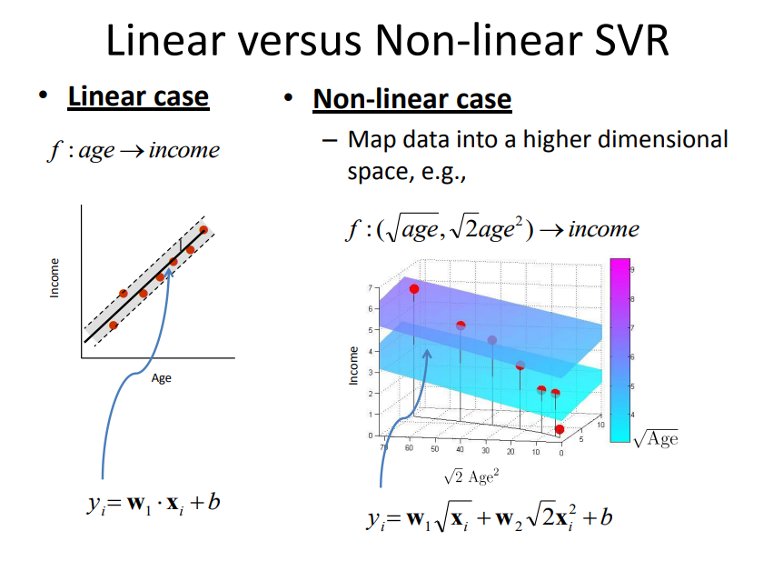

Slide 9
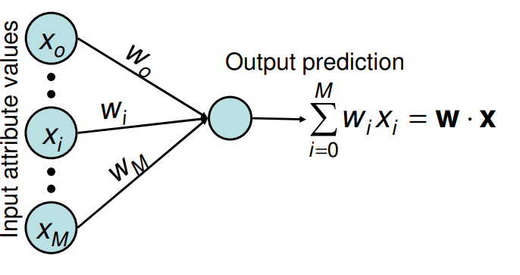
Regression: Neural Networks

Slide 10
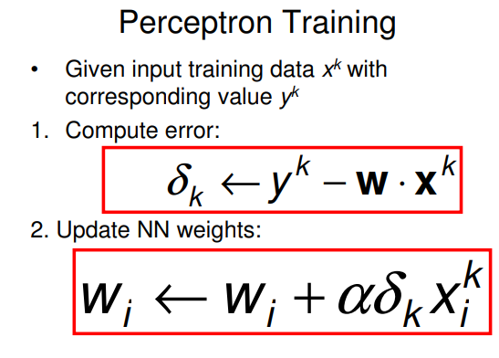
Regression: Neural Networks

Slide 11
Regression: Neural Networks
Update has many names: delta rule, gradient rule, LMS rule
Update is guaranteed to converge to the best linear fit (global minimum of E)
Of course, there are more direct ways of solving the linear regression problem by using linear algebra techniques. It boils down to a simple matrix inversion (not shown here).
In fact, the perceptron training algorithm can be much, much slower than the direct solution
Use of MLP with Backpropagation for Non-Linear Regression

Slide 12
Perceptron Learning Algorithm
First neural network learning model in the 1960’s
Simple and limited (single layer model)
Basic concepts are similar for multi-layer models, so this is a good learning tool
Still used in some current applications (large business problems, where intelligibility is needed, etc.)

Slide 13
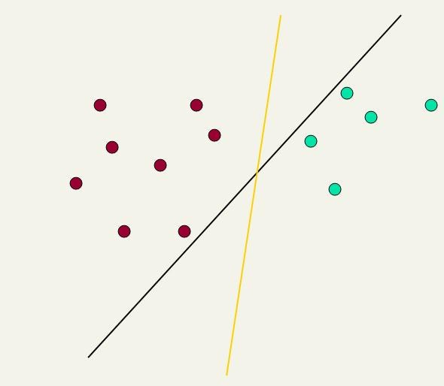
Linear classifiers: Which Hyperplane?
Ch. 15
Lots of possible solutions for a, b, c.
Some methods find a separating hyperplane, but not the optimal one [according to some criterion of expected goodness]
E.g., perceptron
Support Vector Machine (SVM) finds an optimal* solution.
Maximizes the distance between the hyperplane and the “difficult points” close to decision boundary
One intuition: if there are no points near the decision surface, then there are no very uncertain classification decisions
This line represents the decision boundary:
ax + by − c = 0
Notes:
But note that Naïve Bayes also finds an optimal solution … just under a different definition of optimality.

Slide 14
Another intuition
Sec. 15.1
If you have to place a fat separator between classes, you have less choices, and so the capacity of the model has been decreased

Slide 15
Support Vector Machine (SVM)
Sec. 15.1
SVMs maximize the margin around the separating hyperplane.
A.k.a. large margin classifiers
The decision function is fully specified by a subset of training samples, the support vectors.
Solving SVMs is a quadratic programming problem
Seen by many as the most successful current text classification method*
Support vectors
Maximizes
margin
Narrower
margin
*but other discriminative methods often perform very similarly

Slide 16
Maximum Margin: Formalization
Sec. 15.1
w: decision hyperplane normal vector
x_{i}: data point i
y_{i}: class of data point i (+1 or -1) NB: Not 1/0
Classifier is: f(x_{i}) = sign(w^{T}x_{i} + b)
Functional margin of x_{i} is: y_{i} (w^{T}x_{i} + b)
But note that we can increase this margin simply by scaling w, b….
Functional margin of dataset is twice the minimum functional margin for any point
The factor of 2 comes from measuring the whole width of the margin

Slide 17
Geometric Margin
Sec. 15.1
Distance from example to the separator is
Examples closest to the hyperplane are support vectors.
Margin ρ of the separator is the width of separation between support vectors of classes.
x
ρ
Derivation of finding r:
Dotted line x’−x is perpendicular to
decision boundary so parallel to w.
Unit vector is w/|w|, so line is rw/|w|.
x’ = x – yrw/|w|.
x’ satisfies w^{T}x’+b = 0.
So w^{T}(x –yrw/|w|) + b = 0
Recall that |w| = sqrt(w^{T}w).
So w^{T}x –yr|w| + b = 0
So, solving for r gives:
r = y(w^{T}x + b)/|w|
r
x′
w
Notes:
Looking for distance r. Dotted line x’-x is perpendicular to decision boundary so parallel to w. Unit vector is w/|w|, so this one is rw/|w|.
x’ = x – rw/|w|. X’ satisfies wx+b = 0.
So wT(x –rw/|w|) + b = 0
Recall that |w| = sqrt(wTw). So, solving for r gives:
r = y(wTx + b)/|w|

Slide 18
Linear SVM Mathematically The linearly separable case
Sec. 15.1
Assume that all data is at least distance 1 from the hyperplane, then the following two constraints follow for a training set {(x_{i} ,y_{i})}
For support vectors, the inequality becomes an equality
Then, since each example’s distance from the hyperplane is
The margin is:
w^{T}x_{i} + b ≥ 1 if y_{i} = 1
w^{T}x_{i} + b ≤ −1 if y_{i} = −1

Slide 19
Linear Support Vector Machine (SVM)
Sec. 15.1
ρ
w^{T}x_{a} + b = 1
Hyperplane
w^{T} x + b = 0
Extra scale constraint:
min_{i=1,…,n} |w^{T}x_{i} + b| = 1
This implies:
w^{T}(x_{a}–x_{b}) = 2
ρ = ||x_{a}–x_{b}||₂ = 2/||w||₂
w^{T}x_{b} + b = -1
w^{T} x + b = 0

Slide 20
Linear SVMs Mathematically (cont.)
Sec. 15.1
Then we can formulate the quadratic optimization problem:
A better formulation (min ||w|| = max 1/ ||w|| ):
Find w and b such that
is maximized; and for all {(x_{i} , y_{i})}
w^{T}x_{i} + b ≥ 1 if y_{i}=1; w^{T}x_{i} + b ≤ -1 if y_{i} = -1
Find w and b such that
Φ(w) =½ w^{T}w is minimized;
and for all {(x_{i} ,y_{i})}: y_{i} (w^{T}x_{i} + b) ≥ 1

Slide 21
Solving the Optimization Problem
Sec. 15.1
This is now optimizing a quadratic function subject to linear constraints
Quadratic optimization problems are a well-known class of mathematical programming problem, and many (intricate) algorithms exist for solving them (with many special ones built for SVMs)
The solution involves constructing a dual problem where a Lagrange multiplier α_{i} is associated with every constraint in the primary problem:
Find w and b such that
Φ(w) =½ w^{T}w is minimized;
and for all {(x_{i} ,y_{i})}: y_{i} (w^{T}x_{i} + b) ≥ 1
Find α₁…α_{N} such that
Q(α) =Σα_{i} - ½ΣΣα_{i}α_{j}y_{i}y_{j}x_{i}^{T}x_{j} is maximized and
(1) Σα_{i}y_{i} = 0
(2) α_{i} ≥ 0 for all α_{i}

Slide 22
The Optimization Problem Solution
Sec. 15.1
The solution has the form:
Each non-zero α_{i} indicates that corresponding x_{i} is a support vector.
Then the classifying function will have the form:
Notice that it relies on an inner product between the test point x and the support vectors x_{i}
We will return to this later.
Also keep in mind that solving the optimization problem involved computing the inner products x_{i}^{T}x_{j} between all pairs of training points.
w =Σα_{i}y_{i}x_{i} b= y_{k}- w^{T}x_{k} for any x_{k} such that α_{k}≠ 0
f(x) = Σα_{i}y_{i}x_{i}^{T}x + b

Slide 23
Soft Margin Classification
Sec. 15.2.1
If the training data is not linearly separable, slack variables ξ_{i} can be added to allow misclassification of difficult or noisy examples.
Allow some errors
Let some points be moved to where they belong, at a cost
Still, try to minimize training set errors, and to place hyperplane “far” from each class (large margin)
ξ_{i}
ξ_{j}

Slide 24
Soft Margin Classification Mathematically
Sec. 15.2.1
The old formulation:
The new formulation incorporating slack variables:
Parameter C can be viewed as a way to control overfitting
A regularization term
Find w and b such that
Φ(w) =½ w^{T}w is minimized and for all {(x_{i} ,y_{i})}
y_{i} (w^{T}x_{i} + b) ≥ 1
Find w and b such that
Φ(w) =½ w^{T}w + CΣξ_{i} is minimized and for all {(x_{i} ,y_{i})}
y_{i} (w^{T}x_{i} + b) ≥ 1- ξ_{i} and ξ_{i} ≥ 0 for all i

Slide 25
Soft Margin Classification – Solution
Sec. 15.2.1
The dual problem for soft margin classification:
Neither slack variables ξ_{i} nor their Lagrange multipliers appear in the dual problem!
Again, x_{i} with non-zero α_{i} will be support vectors.
Solution to the dual problem is:
Find α₁…α_{N} such that
Q(α) =Σα_{i} - ½ΣΣα_{i}α_{j}y_{i}y_{j}x_{i}^{T}x_{j} is maximized and
(1) Σα_{i}y_{i} = 0
(2) 0 ≤ α_{i} ≤ C for all α_{i}
w is not needed explicitly for classification!
w = Σα_{i}y_{i}x_{i}
b = y_{k}(1- ξ_{k}) - w^{T}x_{k} where k = argmax α_{k’}
k’
f(x) = Σα_{i}y_{i}x_{i}^{T}x + b

Slide 26
Classification with SVMs
Sec. 15.1
Given a new point x, we can score its projection onto the hyperplane normal:
I.e., compute score: w^{T}x + b = Σα_{i}y_{i}x_{i}^{T}x + b
Decide class based on whether < or > 0
Can set confidence threshold t.
Score > t: yes
Score < -t: no
Else: don’t know
1
0
-1

Slide 27
Linear SVMs: Summary
Sec. 15.2.1
The classifier is a separating hyperplane.
The most “important” training points are the support vectors; they define the hyperplane.
Quadratic optimization algorithms can identify which training points x_{i} are support vectors with non-zero Lagrangian multipliers α_{i}.
Both in the dual formulation of the problem and in the solution, training points appear only inside inner products:
Find α₁…α_{N} such that
Q(α) =Σα_{i} - ½ΣΣα_{i}α_{j}y_{i}y_{j}x_{i}^{T}x_{j} is maximized and
(1) Σα_{i}y_{i} = 0
(2) 0 ≤ α_{i} ≤ C for all α_{i}
f(x) = Σα_{i}y_{i}x_{i}^{T}x + b

Slide 28
Non-linear SVMs
Sec. 15.2.3
Datasets that are linearly separable (with some noise) work out great:
But what are we going to do if the dataset is just too hard?
How about … mapping data to a higher-dimensional space:
0
x
0
x
x²
0
x

Slide 29
Non-linear SVMs: Feature spaces
Sec. 15.2.3
General idea: the original feature space can always be mapped to some higher-dimensional feature space where the training set is separable:
Φ: x → φ(x)

Slide 30
The “Kernel Trick”
Sec. 15.2.3
The linear classifier relies on an inner product between vectors K(x_{i},x_{j})=x_{i}^{T}x_{j}
If every datapoint is mapped into high-dimensional space via some transformation Φ: x → φ(x), the inner product becomes:
K(x_{i},x_{j})= φ(x_{i}) ^{T}φ(x_{j})
A kernel function is some function that corresponds to an inner product in some expanded feature space.
Example:
2-dimensional vectors x=[x₁ x₂]; let K(x_{i},x_{j})=(1 + x_{i}^{T}x_{j})²,
Need to show that K(x_{i},x_{j})= φ(x_{i}) ^{T}φ(x_{j}):
K(x_{i},x_{j})=(1 + x_{i}^{T}x_{j})²,= 1+ x_{i1}²x_{j1}² + 2 x_{i1}x_{j1} x_{i2}x_{j2}+ x_{i2}²x_{j2}² + 2x_{i1}x_{j1} + 2x_{i2}x_{j2}=
= [1 x_{i1}² √2 x_{i1}x_{i2} x_{i2}² √2x_{i1} √2x_{i2}]^{T} [1 x_{j1}² √2 x_{j1}x_{j2} x_{j2}² √2x_{j1} √2x_{j2}]
= φ(x_{i}) ^{T}φ(x_{j}) where φ(x) = [1 x₁² √2 x₁x₂ x₂² √2x₁ √2x₂]

Slide 31

Kernels
Sec. 15.2.3
Why use kernels?
Make non-separable problem separable.
Map data into better representational space
Common kernels
Linear
Polynomial K(x,z) = (1+x^{T}z)^{d}
Gives feature conjunctions
Radial basis function (infinite dimensional space)
Haven’t been very useful in text classification

Slide 32

Classification: Perceptron Node – Threshold Logic Unit
x₁
w₁
x₂
w₂
$$θ$$
z
x_{n}
w_{n}

Slide 33
Perceptron Node – Threshold Logic Unit
x₁
w₁
x₂
w₂
$$θ$$
z
x_{n}
w_{n}
Learn weights such that an objective function is maximized.
What objective function should we use?
What learning algorithm should we use?
Notes:
What parameters and objective function

Slide 34
Perceptron Learning Algorithm
x₁
.4
.1
z
x₂
-.2
x₁
x₂
t
.8
.3
1
.4
.1
0

Slide 35
First Training Instance
.8
.4
.1
z
=1
.3
-.2
net = .8*.4 + .3*-.2 = .26
x₁
x₂
t
.8
.3
1
.4
.1
0

Slide 36
Second Training Instance
.4
.4
.1
z
=1
.1
-.2
net = .4*.4 + .1*-.2 = .14
x₁
x₂
t
.8
.3
1
Δw_{i} =
(t - z)
∗ c
∗ x_{i}
.4
.1
0

Slide 37
Perceptron Rule Learning
Δw_{i} = c(t – z) x_{i}
Where w_{i} is the weight from input i to perceptron node, c is the learning rate, t is the target for the current instance, z is the current output, and x_{i} is i^{th} input
Least perturbation principle
Only change weights if there is an error
small c rather than changing weights sufficient to make current pattern correct
Scale by x_{i}
Create a perceptron node with n inputs
Iteratively apply a pattern from the training set and apply the perceptron rule
Each iteration through the training set is an epoch
Continue training until total training set error ceases to improve
Perceptron Convergence Theorem: Guaranteed to find a solution in finite time if a solution exists
Notes:
Author uses y-t and thus negates the delta w

Slide 38
How to Handle Multi-Class Output
This is an issue with any learning model which only supports binary classification (perceptron, SVM, etc.)
Create 1 perceptron for each output class, where the training set considers all other classes to be negative examples (one vs the rest)
Run all perceptrons on novel data and set the output to the class of the perceptron which outputs high
If there is a tie, choose the perceptron with the highest net value
Create 1 perceptron for each pair of output classes, where the training set only contains examples from the 2 classes (one vs one)
Run all perceptrons on novel data and set the output to be the class with the most wins (votes) from the perceptrons
In case of a tie, use the net values to decide
Number of models grows by the square of the output classes
Notes:
Use next slide (Iris) as example

